Slide 1

Mitigating Cybersecurity Threats in Internet of Things (IoT) Devices: Strategies and Solutions
Seminar on Emerging Technologies
By Clifford Edewor

Slide 2
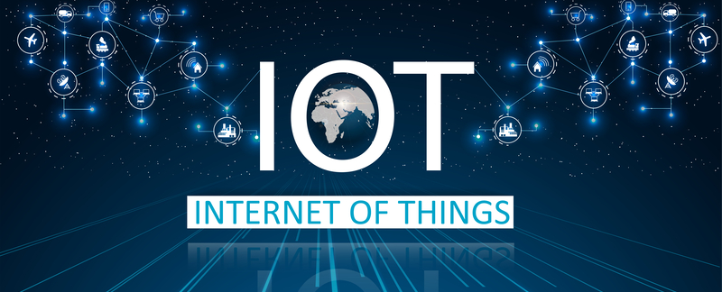
Introduction To IoT
What is IoT?
A network of interconnected devices that collect, transmit, and process data without human intervention.
Over 15 billion connected IoT devices globally as of 2023, expected to increase exponentially.

Slide 3
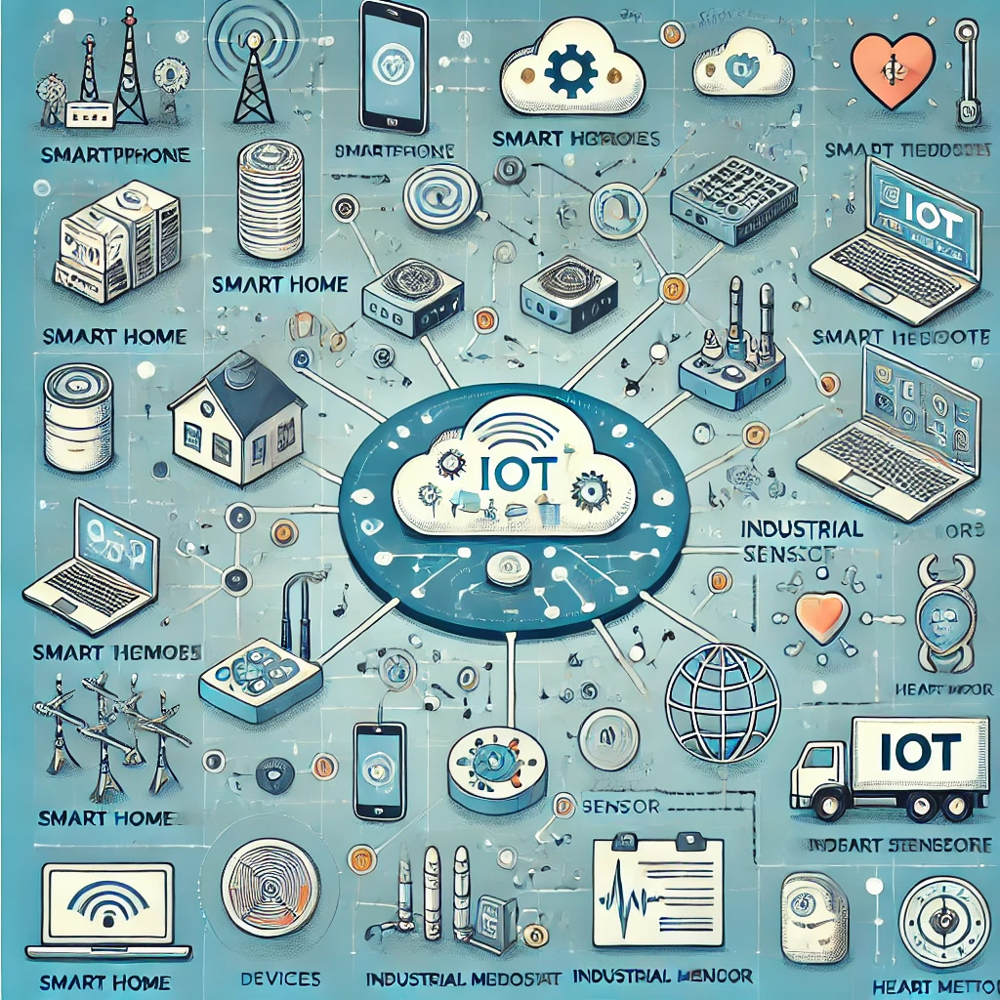
IoT Ecosystem Overview
An illustration showing various interconnected IoT devices and systems.

Slide 4

Cybersecurity Challenges in IoT
IoT devices introduce significant cybersecurity risks.
Challenges include resource constraints, lack of robust security measures, and decentralized nature.
Vulnerabilities to data breaches, malware, and physical attacks.

Slide 5

Current Landscape of IoT Cybersecurity Threats
Types of IoT Devices:
Smartphones
Smart Home Devices
Wearable Devices Industrial IoT
Medical Devices.

Slide 6
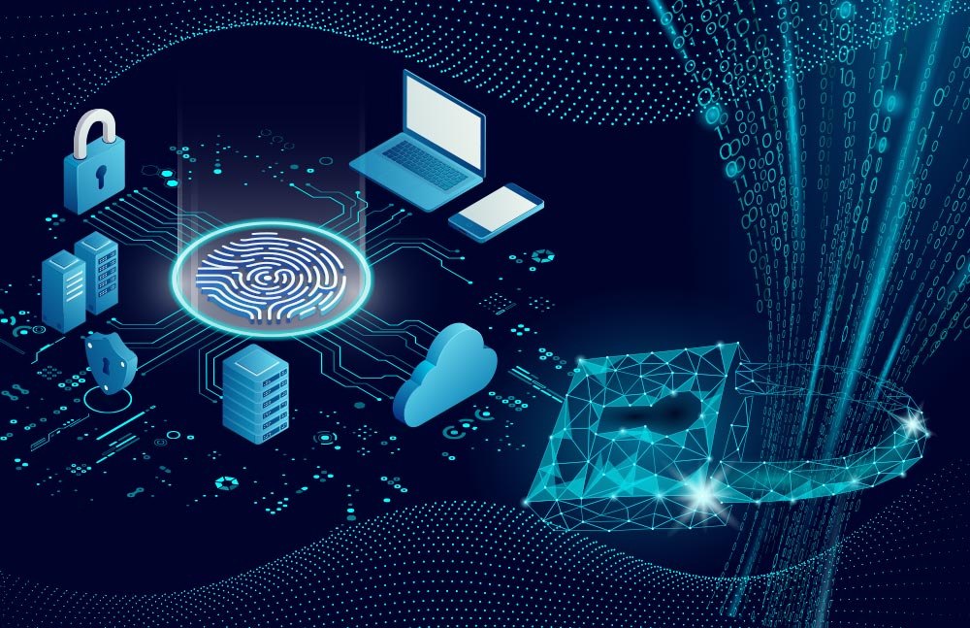
Common Security Threats in IoT
Botnets: Malware enables attackers to access IoT devices and infiltrate networks.
Weak Passwords: Default or simple passwords make devices easy targets.
Data Theft: Attackers steal sensitive financial or personal information.
DoS/DDoS Attacks: Overloading devices or networks with traffic disrupts services.

Slide 7

Impact of IoT Cybersecurity Threats
On Individuals: Identity theft, invasion of privacy, and physical harm.
On Organizations: Operational disruptions, data loss, financial losses, and reputational damage.
On Critical Infrastructure: Power outages, compromised public safety.

Slide 8

The Mirai botnet: Mirai is a botnet malware that exploits poorly protected IoT devices. In 2016, it infected IoT devices by leveraging weak credentials (e.g., default passwords) to build a network of compromised devices. This launched massive DDoS attacks, disrupting major websites like Amazon, Twitter, and Netflix.
The Meris botnet: Meris is an advanced botnet malware, an augmented and refined version of Mirai. It exploits vulnerabilities in IoT devices, particularly targeting routers with outdated firmware, to launch powerful DDoS attacks, peaking at 21.8 million requests per second (RPS).

Slide 9

Strategies for Mitigating Cybersecurity Threats In IoT Devices
Device-Level Security: Strong authentication, encryption, firmware updates, physical hardening.
Network-Level Security: Network segmentation, firewalls, intrusion detection systems (IDS).
Data Security: Data minimization, tokenization, regular backups, IoT Security by Design, and Legal/Regulatory Approaches.

Slide 10

Solutions and Future Directions
Automate
Regular Updates: Automate firmware and software updates to address vulnerabilities.
Implement
Device Identity Management: Implement strong authentication and authorization.
Encrypt
End-to-End Encryption: Encrypt data across all IoT communications.
Use
AI and ML Security: Use AI and ML for advanced threat detection and response.
Training
User Training: Enhance security awareness through targeted training programs.

Slide 11

Conclusion
Securing IoT devices requires a multi-faceted approach with regular updates, strong device identity management, and encryption. Advanced technologies like AI/ML and blockchain help mitigate risks from botnets. Collaboration among manufacturers, governments, and users is crucial for a secure and evolving IoT ecosystem.

Slide 12
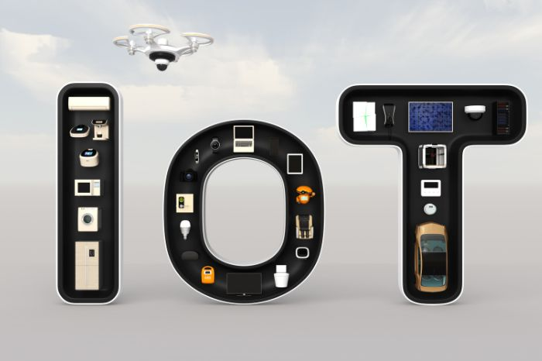
References
1. Baker, W., Hutton, A., & Hylender, C. (2023). The IoT Cybersecurity Threat Landscape: Vulnerabilities and Mitigation Strategies. Journal of Cybersecurity, 19(4), 45-67.
2. National Institute of Standards and Technology (NIST). (2020). NIST Framework for Improving Critical Infrastructure Cybersecurity. https://www.nist.gov/cyberframework.
3. Williams, J. (2022). Securing the Internet of Things: Challenges and Solutions. Cybersecurity Insights, 32(1), 101-119.
4. Federal Trade Commission (FTC). (2019). Privacy & Security Implications of the Internet of Things. https://www.ftc.gov/reports/privacy-security-iot.
5. Cisco Systems. (2021). The Role of Network-Level Security in IoT Protection. Cisco Security White Paper. https://www.cisco.com/security/iot.

